Slide 1
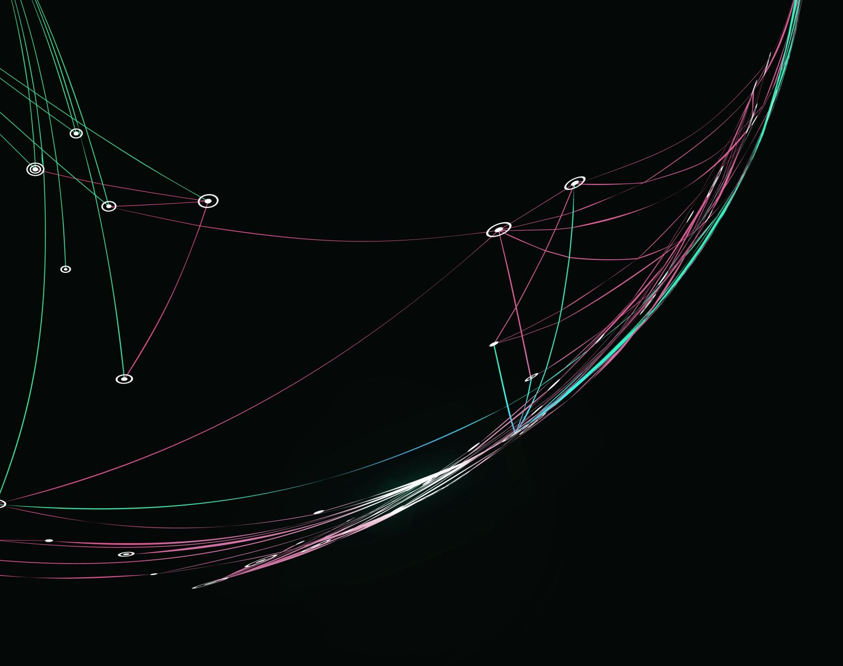
Promotion of independent work
Final delivery
Human computer interaction

Slide 2
Deliverys

Slide 3
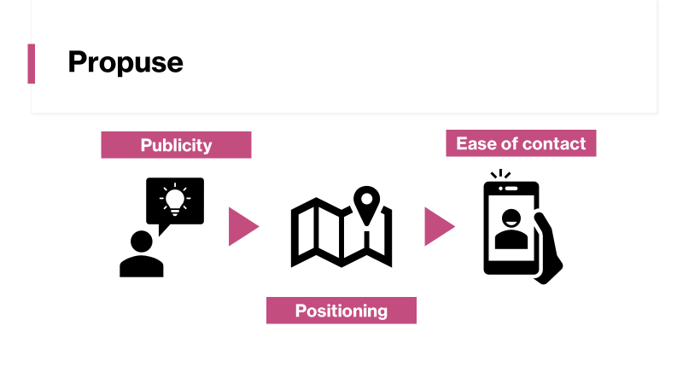
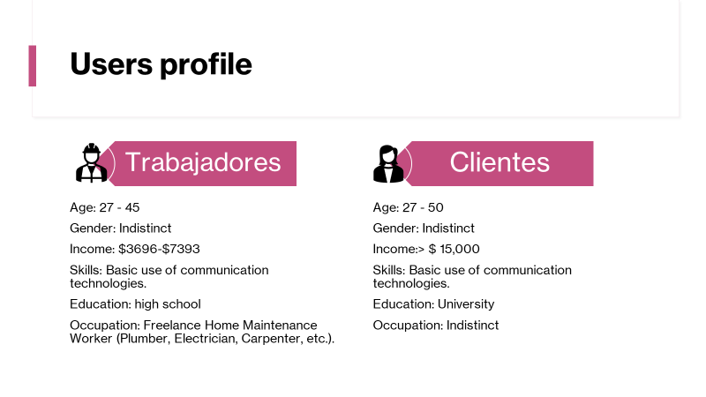
First delivery
Notes:
Throughout each of the deliveries we focus on the development of different artifacts, so it is not so easy to see contrast. During the first installment, we only defined the project as such, thinking about the problem we wanted to attack, and we developed the interviews to get information focused on the target user, which would allow us to adapt to their true needs and opinions. However, the data collection could not be completed by the date of delivery, becoming an activity developed during the time of the second.

Slide 4
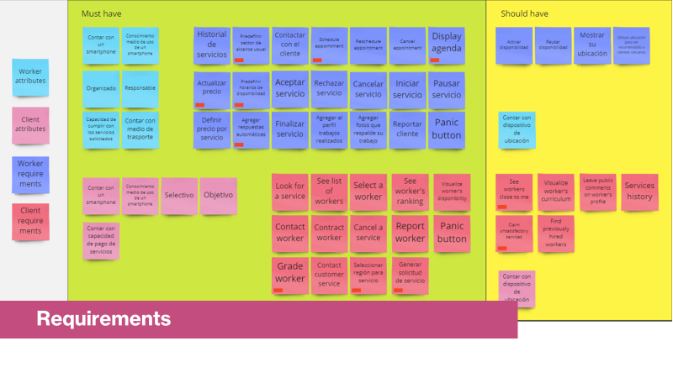
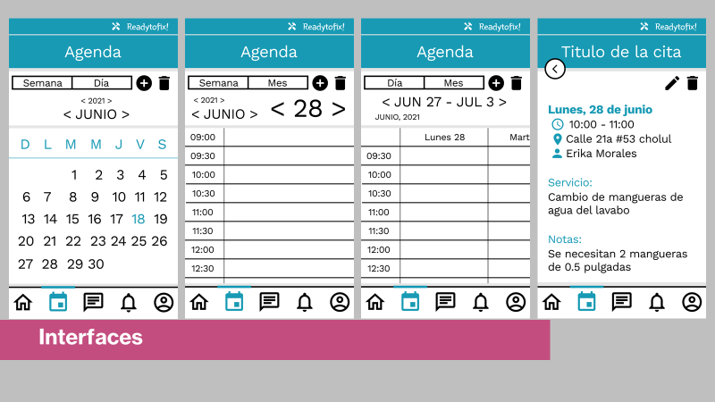
Second delivery
Notes:
Mainly, when we finally concluded the users and scenarios, we had already begun to analyze the requirements that we were going to include, so there was a need to add and modify some of them. To mention one in specific, we could mention the method for workers to contact clients close to them, since the possible lack of internet connection had to be taken into account at all times, which makes it difficult to share their location, and it was created an alternative in which this connection is not necessary.

Slide 5
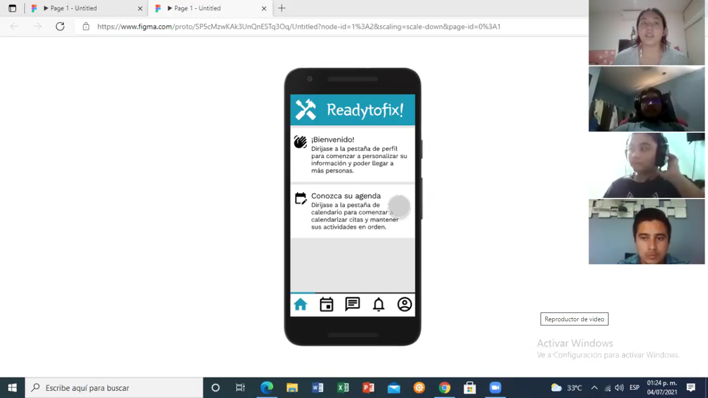
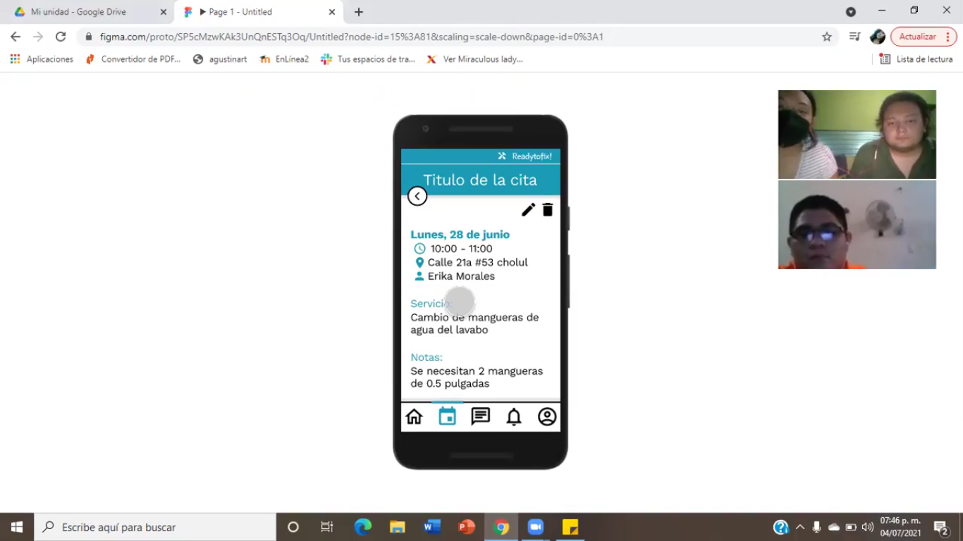
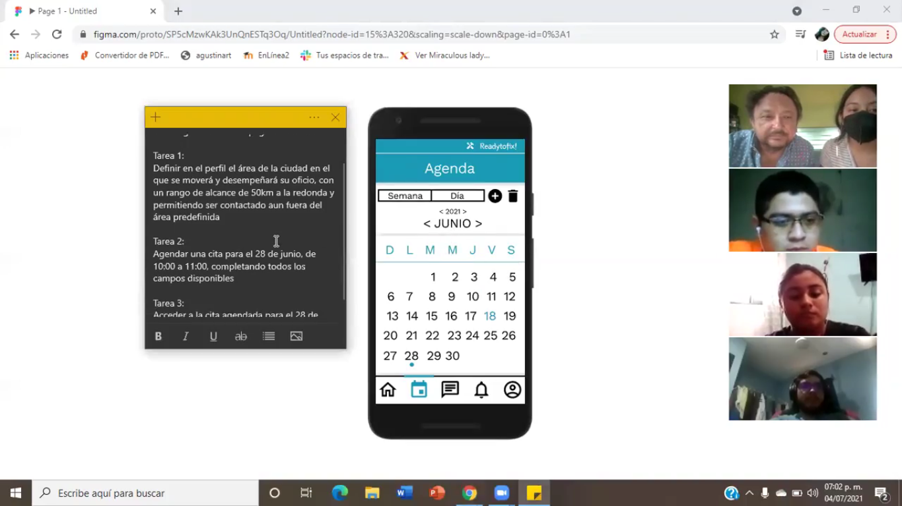
Usability tests
Final delivery
Notes:
In addition, it also had a considerable impact during the development stage of the interface prototypes, starting with the fact of being able to have a guideline of what would be the requirements that could be considered most important, as well as complicated or confusing, depending on the profiles obtained, and finally for the development of the prototypes, based on the qualities of our people to be able to plan interfaces focused on your comfort.
It is then that we were able to test our designs with real users, which led us once again to understand their needs, and to be able to plan improvements for their comfort.

Slide 6
Human-centered design metodology phases

Slide 7
Discovering and listening

Slide 8



Problematic
55.9M
$3.696 – $7.393
$15, 735
Active population
60.7% monthly salary
Monthly family spending
INEGI, 2018 - 2020
Independent work
Limited outreach resources
Notes:
For the first step in the Project developement, we discovered and reserch about the poblematic we would aboard, obtaining alarming figures about the work in Mexico, so we decide to develop a tool that can help people that work independiently in the home mainteinance area

Slide 9
Users profile
Workers
Clients
Age: 27 - 45
Gender: Indistinct
Income: $3696-$7393
Skills: Basic use of communication technologies.
Education: high school
Occupation: Freelance Home Maintenance Worker (Plumber, Electrician, Carpenter, etc.).
Age: 27 - 50
Gender: Indistinct
Income:> $ 15,000
Skills: Basic use of communication technologies.
Education: University
Occupation: Indistinct
Notes:
The next step was to identify the profile of the users we would have, and start reserching about them to create the personas and scenarios

Slide 10
Intreviews
Do you have any method or means to get to your clients? Do you consider it effective?
What do you consider to be the main limitations you have in reaching your target audience?
Do you have any idea what you could do to increase the scope of your work?
Do you have a mobile device? Would you comment on the model / brand / capacity?
Do you have internet access at home?
Do you have a plan or portable internet access (from your mobile device)?
How do you usually keep in touch with your customers?
How constantly do you contract maintenance services for your home?
How do you usually meet or contact the workers you hire for these jobs? Are you safe and comfortable with this method?
Do you have any idea how you would like or would facilitate the contact and contract process of these servers?
Do you have a mobile device? Would you comment on the model / brand / capacity?
Do you have internet access at home?
Do you have a plan or portable internet access (from your mobile device)?
What applications do you usually use on your mobile phone? How skilled do you consider yourself to be in its use?
Notes:
We plan the intreviews and aplied them , but becouse of the covid we only reach 3 of each users

Slide 11
Personas
Full document: https://github.com/Suemi412/HCIProject/blob/Final-delivery/Perfiles_Personas_Escenarios.docx
Enrique López
Erika Morales
Age: 32 years old
Education: some college
Occupation: Plumber (8 years of experience)
-He is a recognized plumber in his suburb
-His work of him is shared by the neighbors
-He does not have a permanent job
-He is called on duty 2-3 times a week.
-He wants to be more recognized, but it is difficult for them to know him outside of his usual circle.
Age: 42 years
Education: University, accountant
Occupation: office worker
-Works 8 hours a day in a company
-Earn enough money to support his entire family.
-She owns her house and likes to give it constant maintenance
-You have had some bad experiences with hiring staff recommended by someone.
Notes:
Finaly for this phase, we create the personas and escenarios, that were helpful to star the requirements definition

Slide 12
Ideate and create

Slide 13
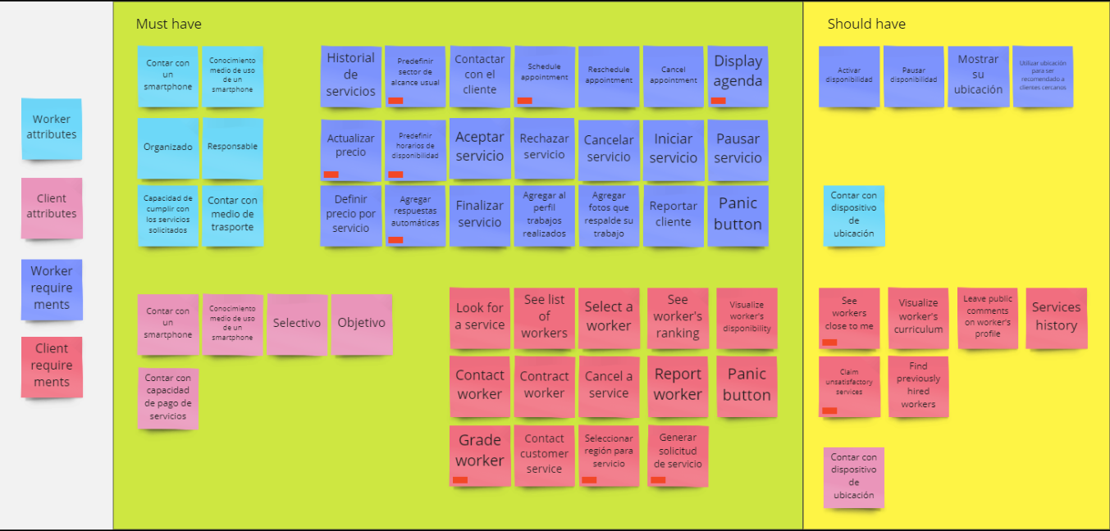
Afinity diagram for requirements selection and priorization
Notes:
We procede to define the requirements during the ideate phase, starting with a brainstrorm, and prioritazing in the afinity diagram

Slide 14
Descripción especifica
Full document: https://github.com/Suemi412/HCIProject/blob/Final-delivery/TerceraRevisionRequerimientos.docx
Requirements especification and use cases
Code | Name | Date | Priority
RF 005 | Make an appointment | 15/06/2021 | Esential
Description | The application must allow the worker to create a new appointment in his agenda, this through a window where important data can be filled in and modified, such as the date and time it will be scheduled, the location and the type of scheduled service, among other data. This will be useful so that the user can keep a record and order regarding the appointments and times available in his agenda, which will also facilitate the attention that he can provide to the client through offering private hours and keeping them constantly pending in this way.
Notes:
So we could proced to the creation of the document of especification of requirements, including each requirement, and some use cases that can be found completed in the link document above

Slide 15
Prototyping and delivery

Slide 16
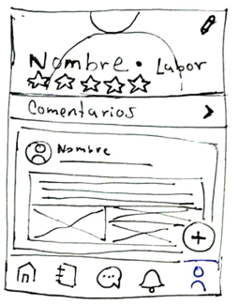
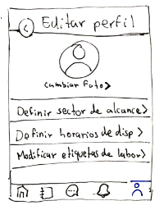
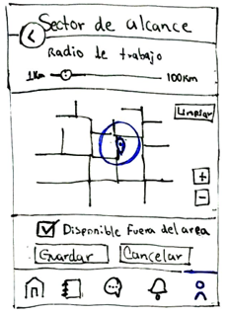
Paper prototype
Notes:
For the final phase, the prototyping, first we create the paper prototype of the interface, based on the use cases and with the path we plan for the requisements we select

Slide 17
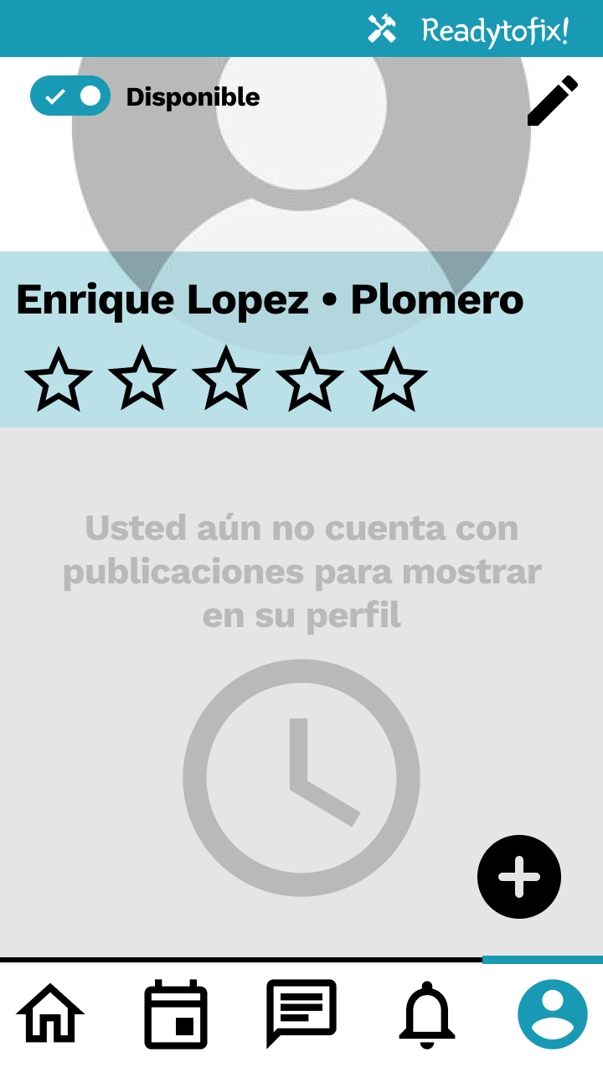
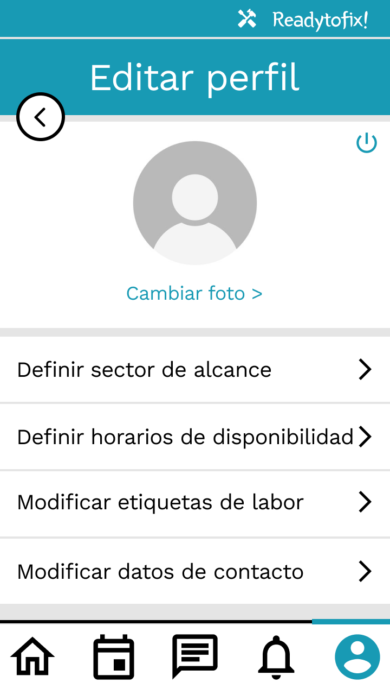
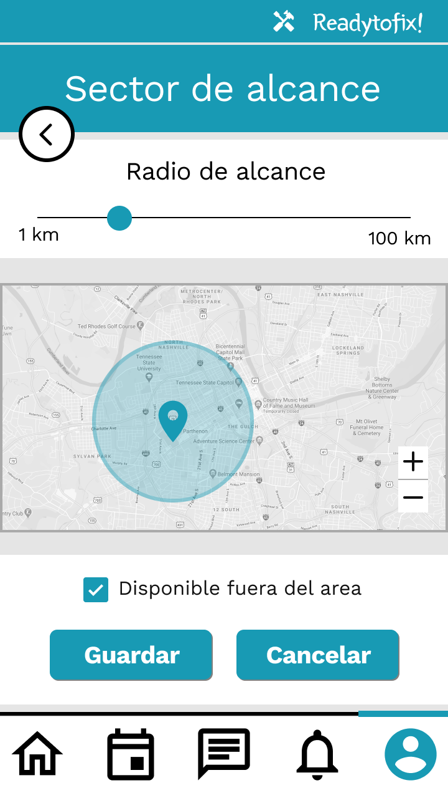
Medium fidelity prototype
Notes:
And after that, we proced to create the medium Fidelity prototypes using figma, developing only the interfaces for the tasks we were going to try on the usability tastes

Slide 18
Usability tests definition
Requerimiento | Atributo | Medidas | Escenario
Predefinir área de alcance | Intuitividad | Numero de interacciones totales para completar la tarea | Definir en el perfil el área de la ciudad en el que se moverá y desempeñará, con un rango de alcance de 50km a la redonda y permitiendo ser contactado aun fuera del área predefinida
 |  | Numero de interacciones incorrectas
 |  | Observación de confusión
Agendar cita - método 1 | Intuitividad | Numero de interacciones totales para completar la tarea | Agendar una cita para el 28 de junio, de 10:00 a 11:00, completando todos los campos disponibles y sin datos prellenados
 |  | Numero de interacciones incorrectas
 |  | Observación de confusión
Agendar cita - método 2 | Intuitividad | Numero de interacciones totales para completar la tarea | Agendar una cita para el 28 de junio, de 10:00 a 11:00, completando todos los campos disponibles y con datos preseleccionados
 |  | Numero de interacciones incorrectas
 |  | Observación de confusión
Navegar agenda | Intuitividad | Numero de interacciones totales para completar la tarea | Acceder a la cita agendada para el 28 de junio desde la vista semanal de la agenda
 |  | Numero de interacciones incorrectas
 |  | Observación de confusión
Notes:
We planed the usability atributes we were going to messure and the way we were to.

Slide 19
Usability tests

Slide 20
Tasks
Predefine scope area | Make an appointment | Browse agenda
Define in the profile the area of ​​the city in which it will move and perform, with a range of 50 km around and allowing to be contacted even outside the predefined area | Schedule an appointment for June 28, from 10:00 to 11:00, filling in all the available fields | Access the appointment scheduled for June 28 from the weekly view of the agenda
Notes:
We define these 3 tasks so our users try to reach on the prototipe, selected for the importance and the factibility of cause trouble to the objective users

Slide 21
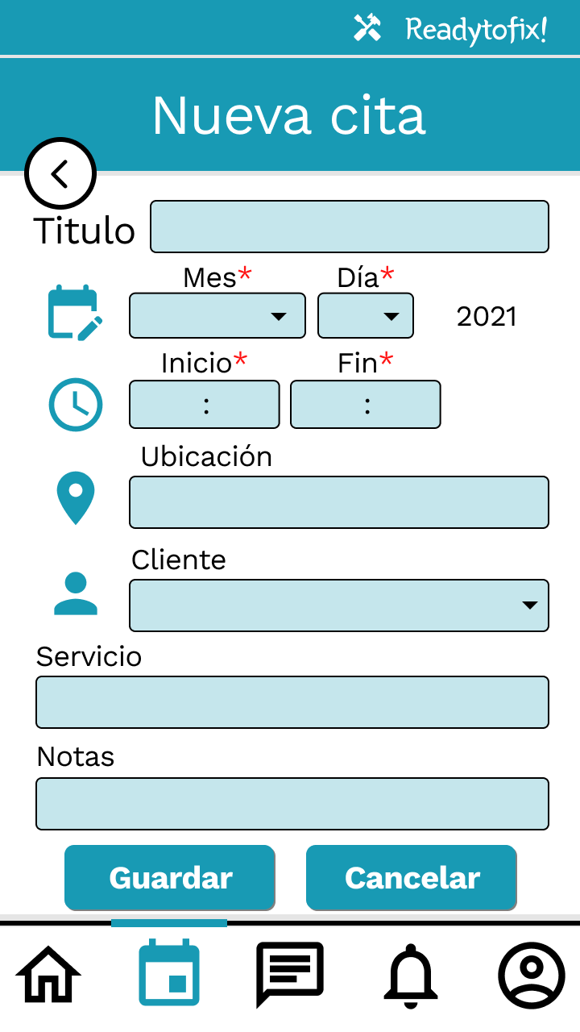
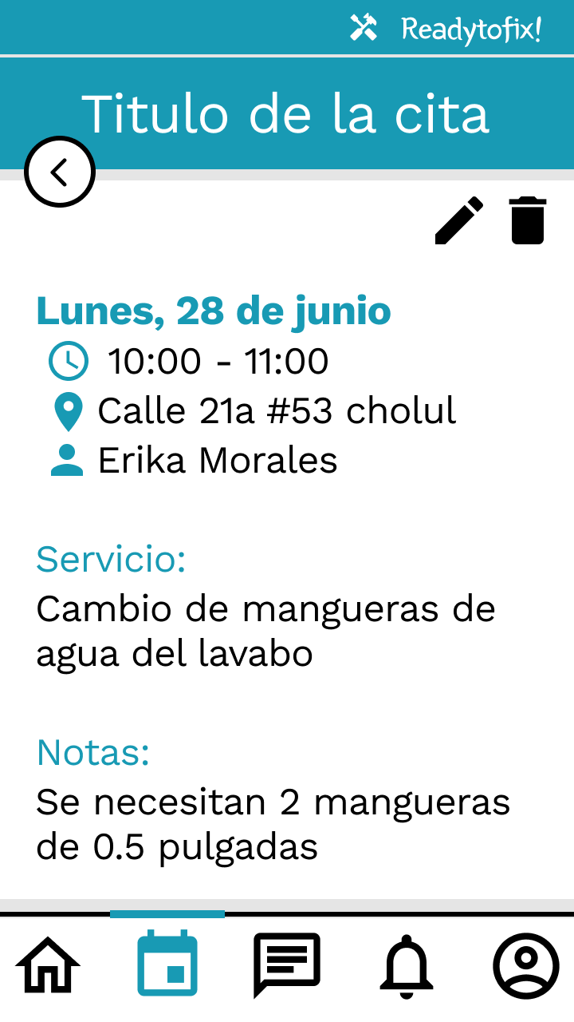
Some interfaces
https://www.figma.com/proto/SP5cMzwKAk3UnQnESTq3Oq/Untitled?node-id=1%3A2&scaling=scale-down&page-id=0%3A1
Notes:
And these are some of the interfaces they saw and interact with. And the full prototipe can be found in the link above

Slide 22
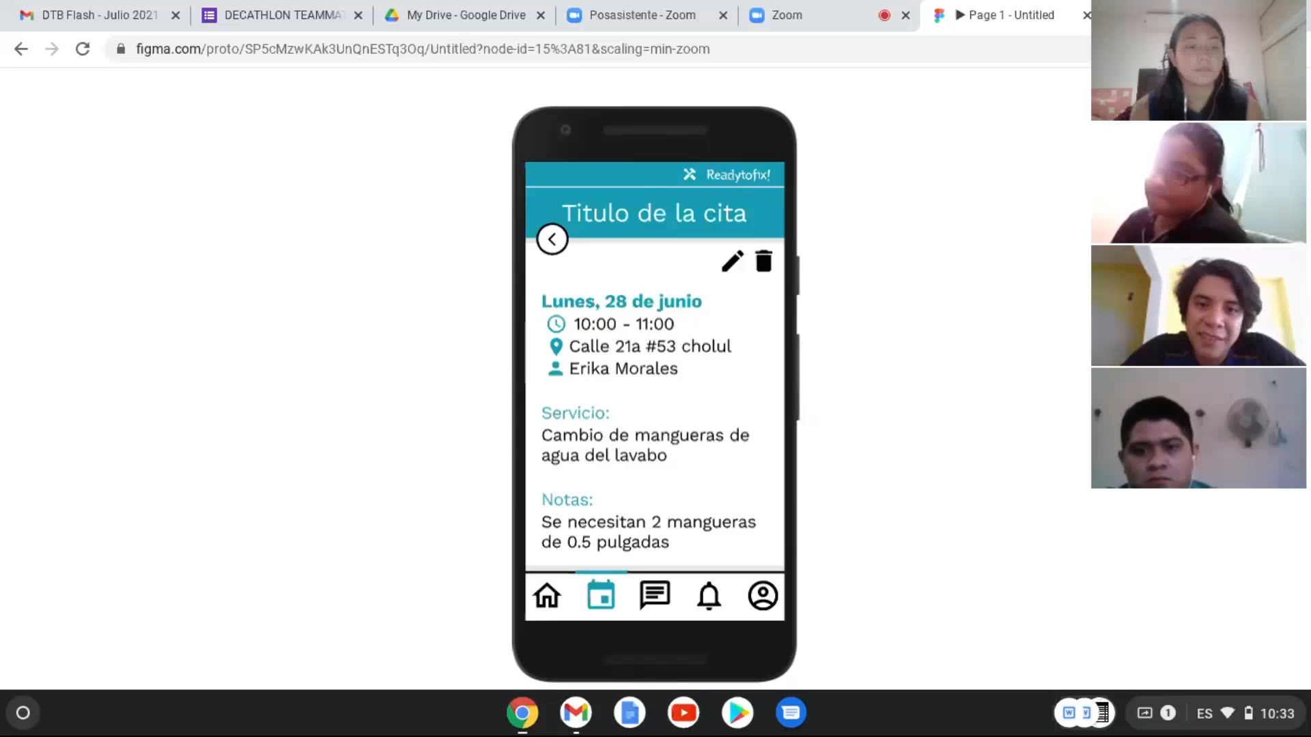
Evidences
Notes:
So, here are some evidences of the implementation, were our testers are giving some feedback of the interfaces they just try

Slide 23
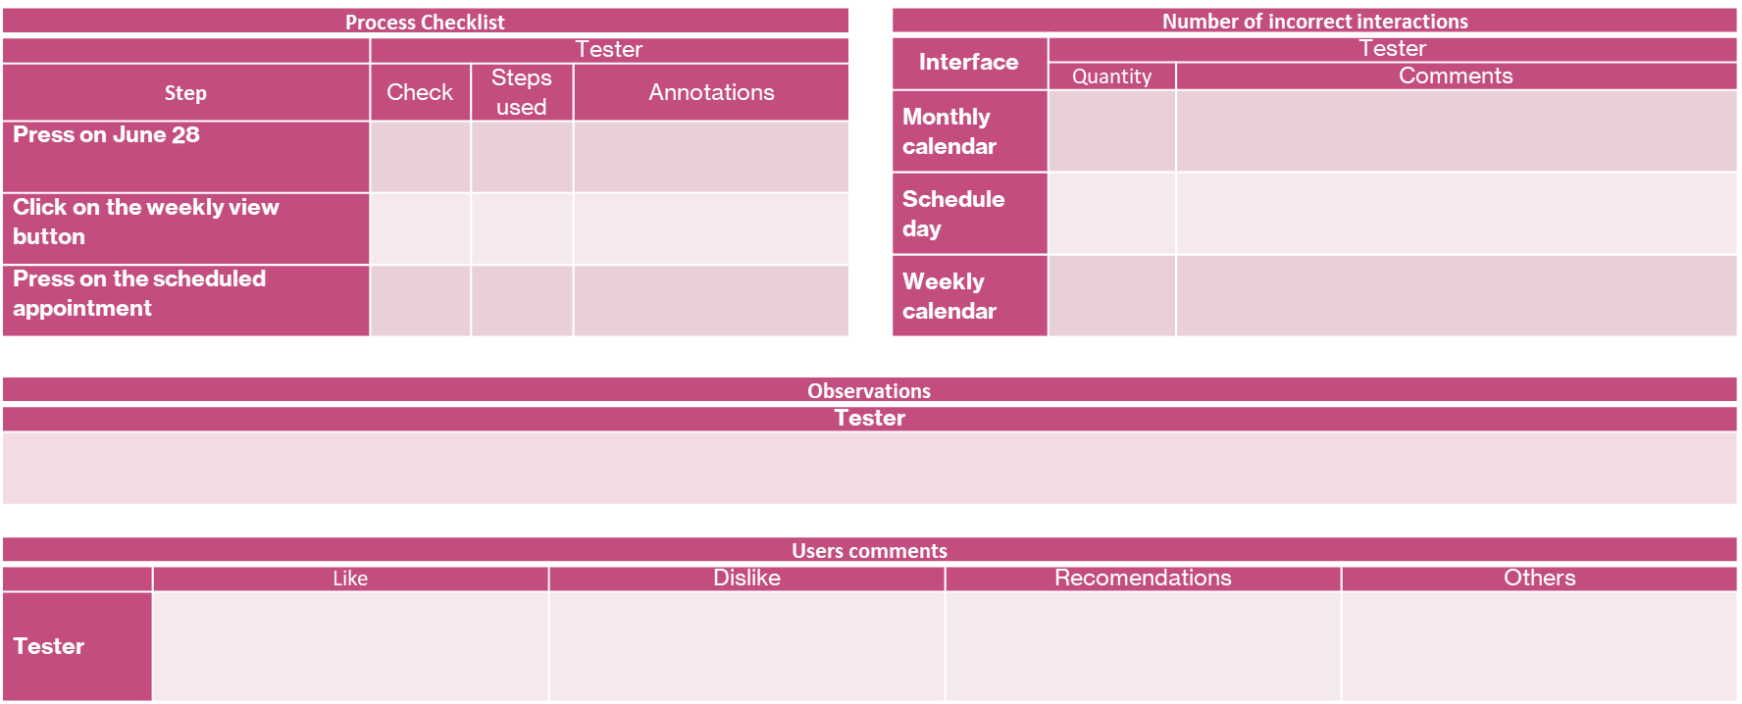
Instruments
Full instruments: https://github.com/Suemi412/HCIProject/blob/Final-delivery/PruebasDeUsabilidad_Aplicado.docx
Notes:
During the proces, we had some instruments to full, each member on the team were taking care of one, while the team leader was dedicated to give the instructions and interact with the user.
After our pilot test, we found some dificulties in the way we used to have orderd the instruments and the space for the anotations, so we modify them until get this, and apply them the to the real testers

Slide 24
First task – Expected steps: 7
Tester 1 | Tester 2 | Tester 3
Steps taken=12 12-7=5 | Steps taken=8 8-7=1 | Steps taken=7 7-7=0
5+1+0=6 6/3=2 Extra interactions average: 2/7 = 28.57%
Status: | Good
Second task – Expected steps: 10
Tester 1 | Tester 2 | Tester 3
Steps taken=11 11-10=1 | Steps taken=10 10-10=0 | Steps taken=10 10-10=0
1+0+0=1 1/3=0.333 Extra interactions average: (1/3)/10 = 3.33%
Status: | Good
Third task – Expected steps: 3
Tester 1 | Tester 2 | Tester 3
Steps taken=3 3-3=0 | Steps taken=3 3-3=0 | Steps taken=3 3-3=0
0+0+0=0 0/3=0 Extra interactions average: 0/3 = 0%
Status: | Good
Extra interactions average | Status
0% - 40% | Good
40% - 70% | Acceptable
>70% | Unacceptable
Notes:
For our results, we consider the average of extra interactions to qualifay the intuitivity of each task of the test, and define the status as showed in the small table
We toke the number of interactions of each tester, and we substract the number expexted, so we got the number of extra interactions. After, we calculate the average of extra interactions for the testers, by add each extra interactions and divide in the 3 testers. Ussing that average, we found the persantage that represent the average into the expected steps, and thats the data we rank from the table. So, in conclution, the prototipe have a Good level of intuitivity.

Slide 25
Learned lessons
Advantages of the human-centered design metodology
Persona method
Usability tests
Notes:
First of all, we were able to realize advantages of the human-centered design metodology during the planeation of any proyect were the user is the goal, and an example would be the same as in the begining. If we would keep the first idea we had of the ubication of workers and develop the application, is very likely that the app would be complitely useless, because, as we found out in the personas process, the users have no constant internet Access, thus, nither they have gps all the time.
Also, during the process of the useability tests, we realize how importand and also hard can be, beacouse even when we have everityn preparated an planed, we will never know how the users can react, understand or misunderstand, driving to a longer process, but the results help a lot to clarify and get ideas to have good proyect

Slide 26
Teamwork

Slide 27
MEMBERS | FUNCTIONS
Suemi Andrea Castillo González | Leader. Main organizer of tasks, obligations and due dates. Principal in charge of the instruments for usability tests and their organization.
Dana Joselyn Bagundo González | Principal in charge of drafting and reviewing documents. Responsible for the observations template. Principal in charge of the poster.
Jairo Josué Cristóbal Franco | Main person in charge of the article. Support for document review. Checklist template manager.
Emmanuel Azcorra Balam | Main person in charge of analysis of results in usability tests. Bad Interaction Template Manager.
INDIVIDUAL CONTRIBUTION
27.89%
25.64%
21.15%
25.32%
Repositorio: https://github.com/Suemi412/HCIProject
Notes:
Here we can see the functions that corresponded to each of the team members, although they really all participated a little in everything, here are their main responsibilities.
The individual contribution qualification is based on an average calculated from the points added throughout the development, these accumulated based on the criteria defined by the team

Slide 28
 | Suemi Andrea Castillo González | Dana Joselyn Bagundo González | Jairo Josué Cristóbal Franco | Emmanuel Azcorra Balam
Amount of group meeting attendance | 7 | 6 | 5 | 7
Amount of participation in group meetings | 7 | 6 | 5 | 7
Number of tasks completed in time (×2) | 8 | 8 | 6 | 6
Fixed bugs in third party deliveries (×0.25) | 0 => 0 | 1 => 0.25 | 3 => 0.75 | 0 => 0
Uncorrected errors in own artifacts (×-0.25) | 1 => -0.25 | 1 => -0.25 | 1 => -0.25 | 1 => -0.25
Total points: 93 | 21.75 | 20 | 16.5 | 19.75
Total contribution | 27.89% | 25.64% | 21.15% | 25.32%
Notes:
Each is counted for each criterion and multiplied by the assigned relevance value. Then the total points to be distributed are added, and the total points obtained by each member. Finally, the percentage of total contribution of each of the members is found.

